Slide 1


H2O Machine Learning Use Cases
Jo-fai (Joe) Chow
Data Scientist
joe@h2o.ai
@matlabulous
satRday #1
MTA TTK, Budapest, Hungary
3rd September, 2016

Slide 2
About Me: Civil Engineer → Data Scientist
2005 - 2015
Water Engineer
Consultant for Utilities
EngD Research
2015 - Present
Data Scientist
Virgin Media (UK)
Domino Data Lab (US)
H2O.ai (US)
Why? Long story – see bit.ly/joe_h2o_talk1

Slide 3
About this Talk
Introduction to H2O
Machine learning use cases from our users

Slide 4
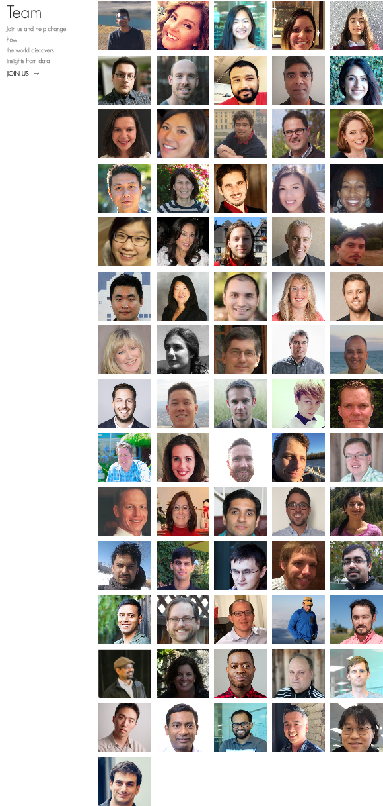
About H2O.ai
H2O.ai, the Company
Team: 80 (71 shown)
Founded in 2012,
HQ: Mountain View, California
H2O, the Platform
Open Source (Apache 2.0)
R, Python, Scala, Java and Web Interfaces
Distributed Algorithms that Scale to Big Data
Works with Laptop, Hadoop & Spark
Jakub
(Kuba)
Joe
Notes:
Team is growing rapidly
Based in Mountain View – I am the only guy in UK/Europe
VC: $34M in total

Slide 5


Scientific Advisory Council

Slide 6
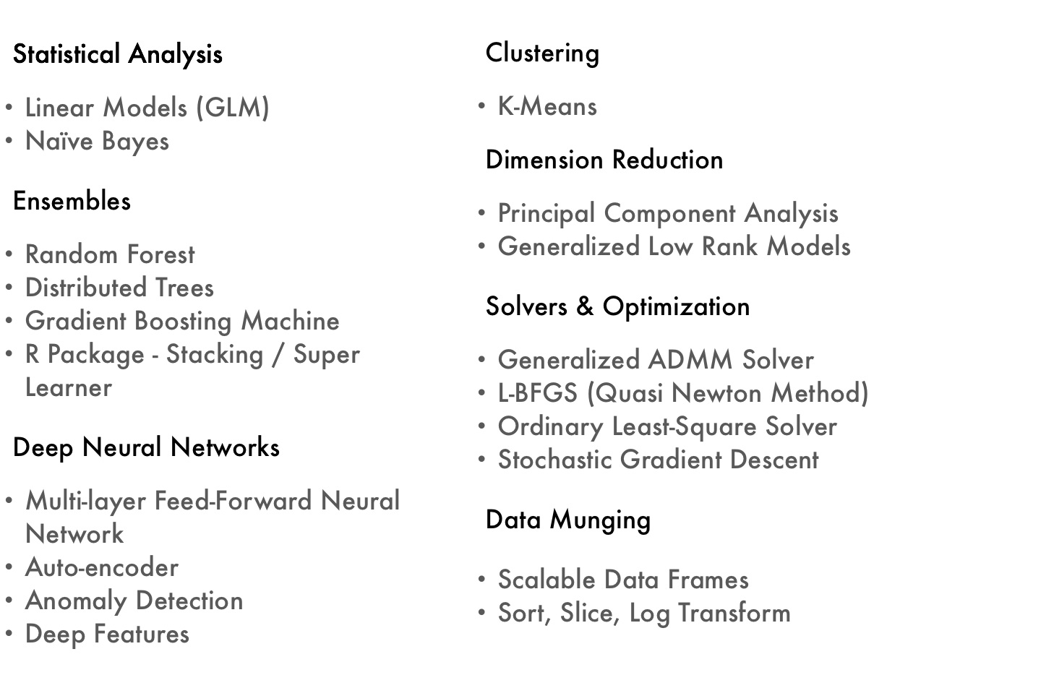
Current Algorithm Overview
See bit.ly/joe_h2o_talk4
satRday
Workshop

Slide 7
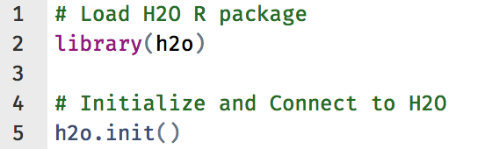
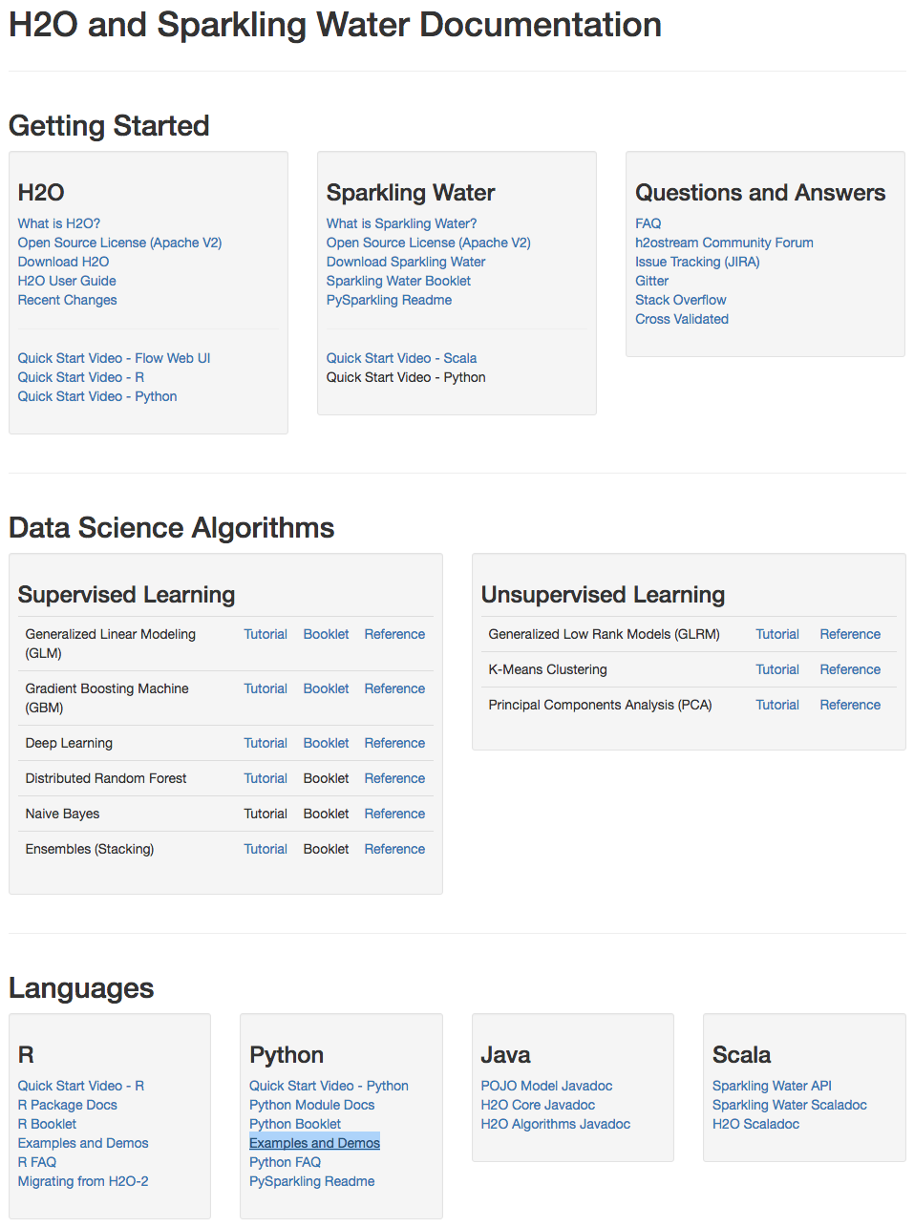
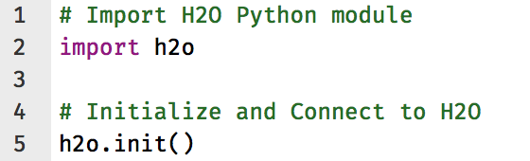
H2O Interfaces – R, Python & Others
R
Python
Resources - docs.h2o.ai

Slide 8
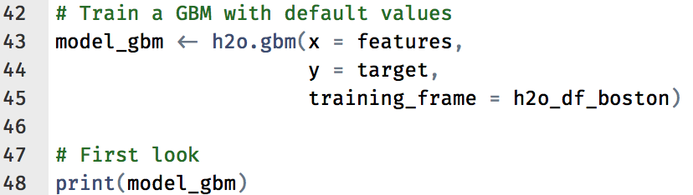
H2O R Code Example
Slide & Code for Workshop:
bit.ly/h2o_budapest_workshop

Slide 9
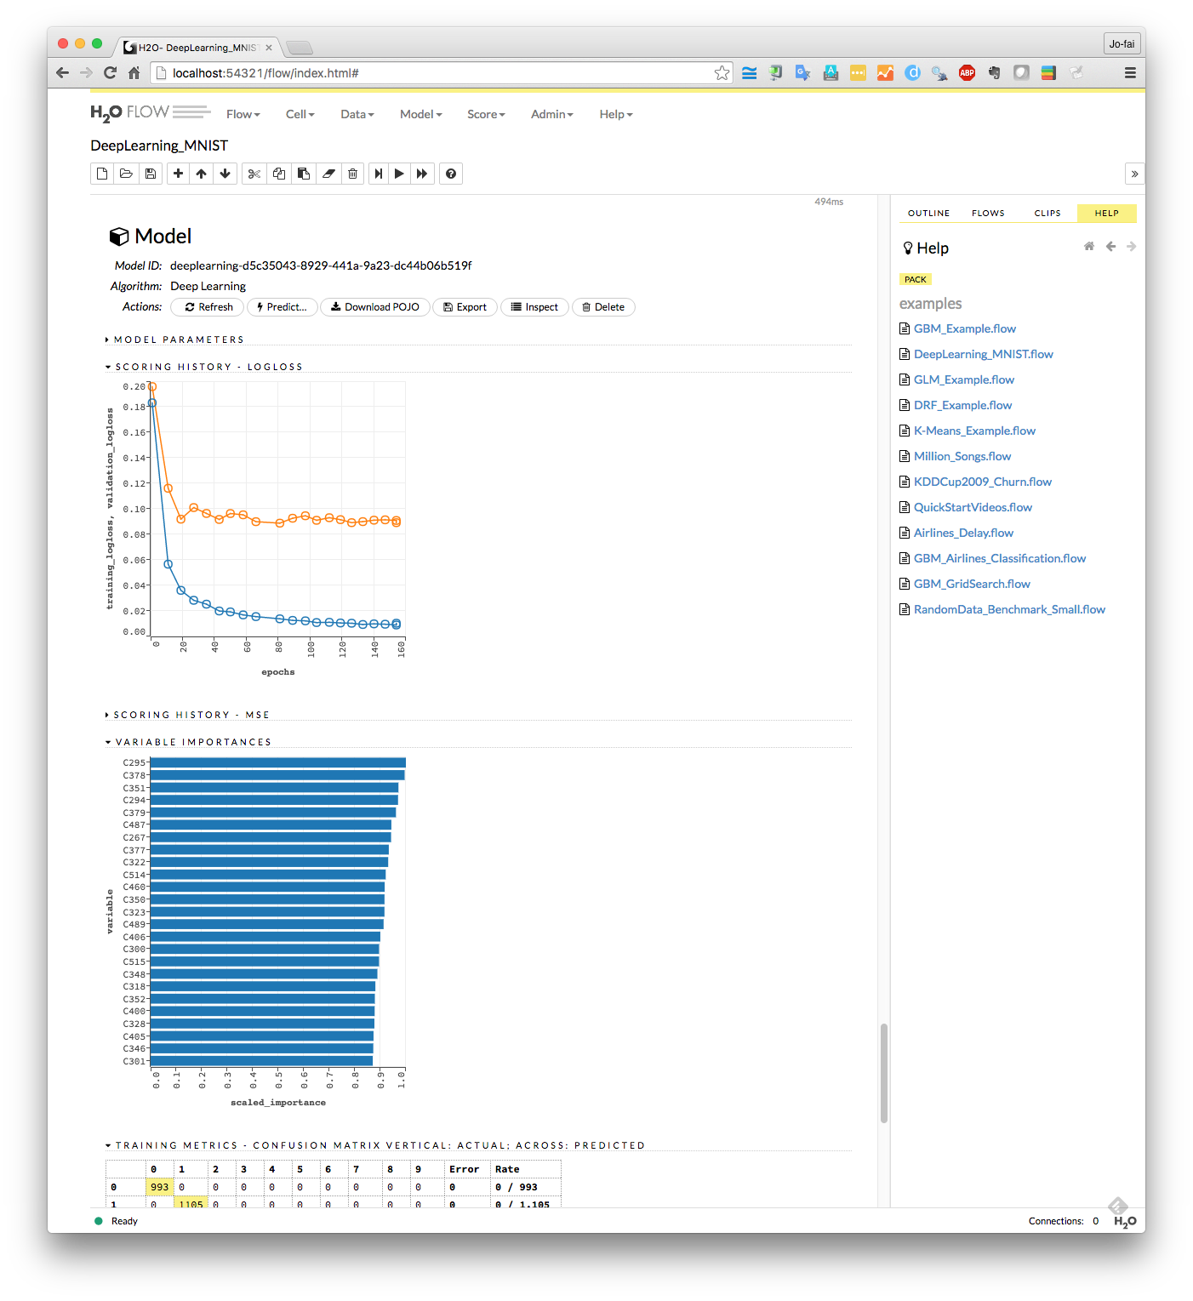
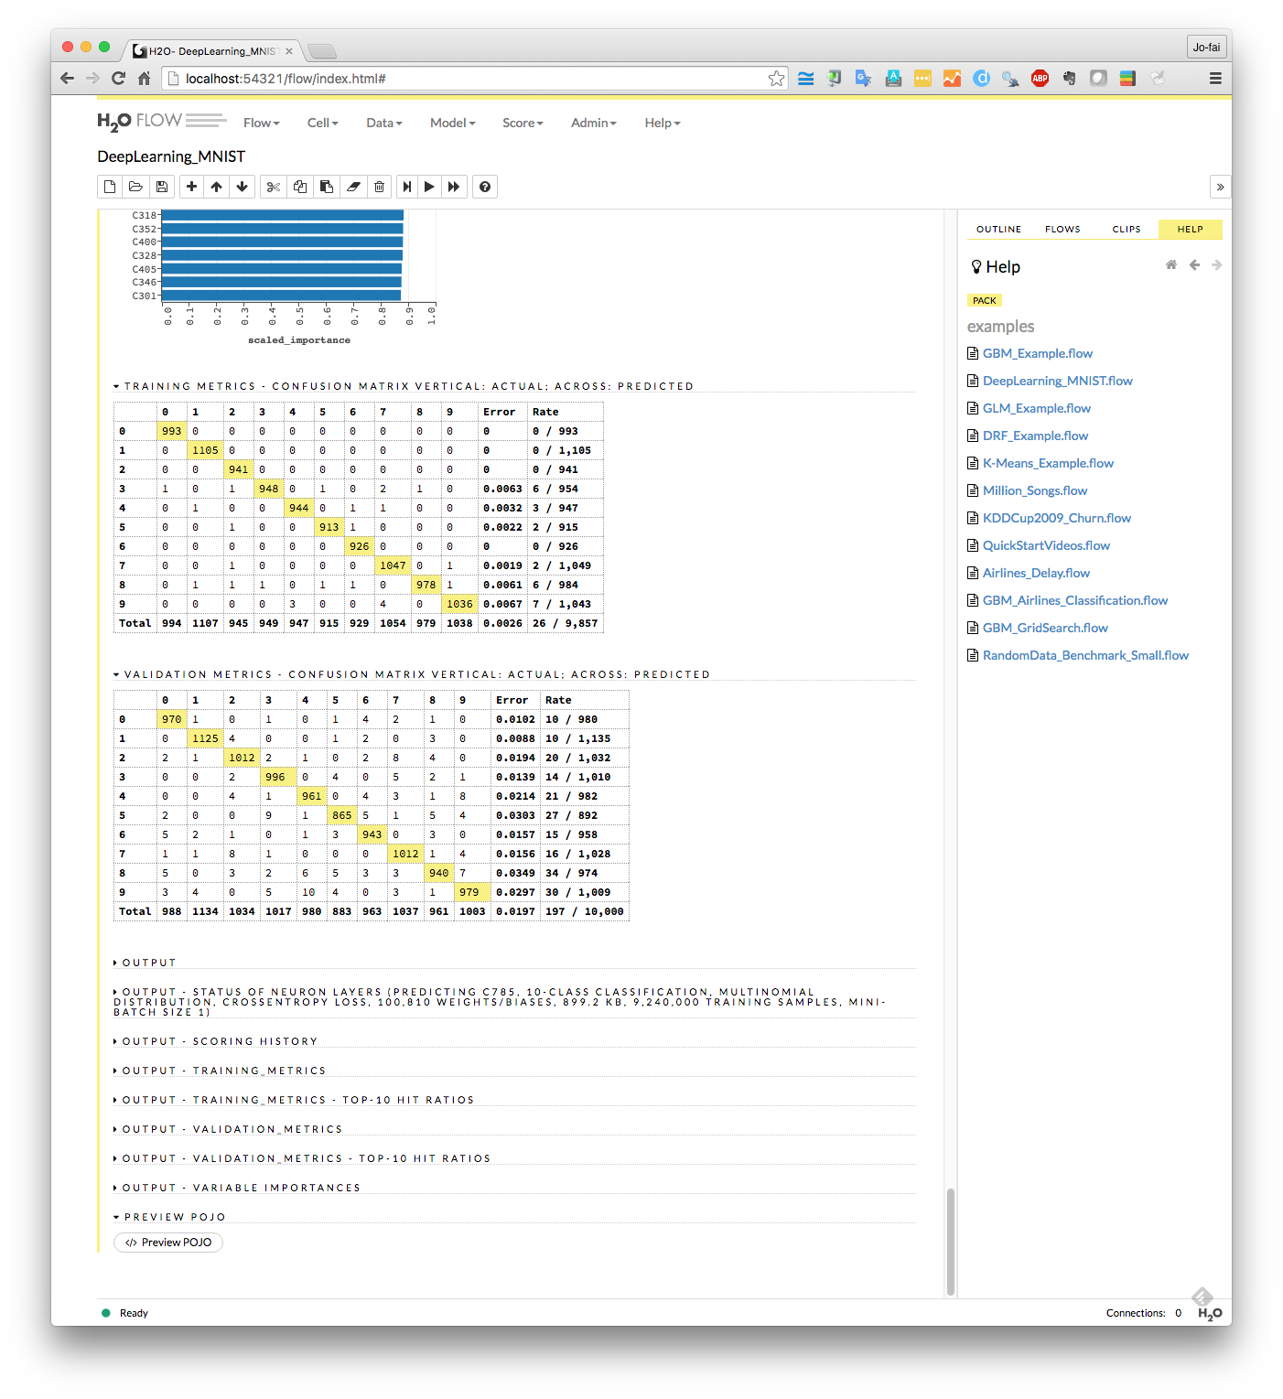
H2O Interfaces – Web (H2O Flow)

Slide 10
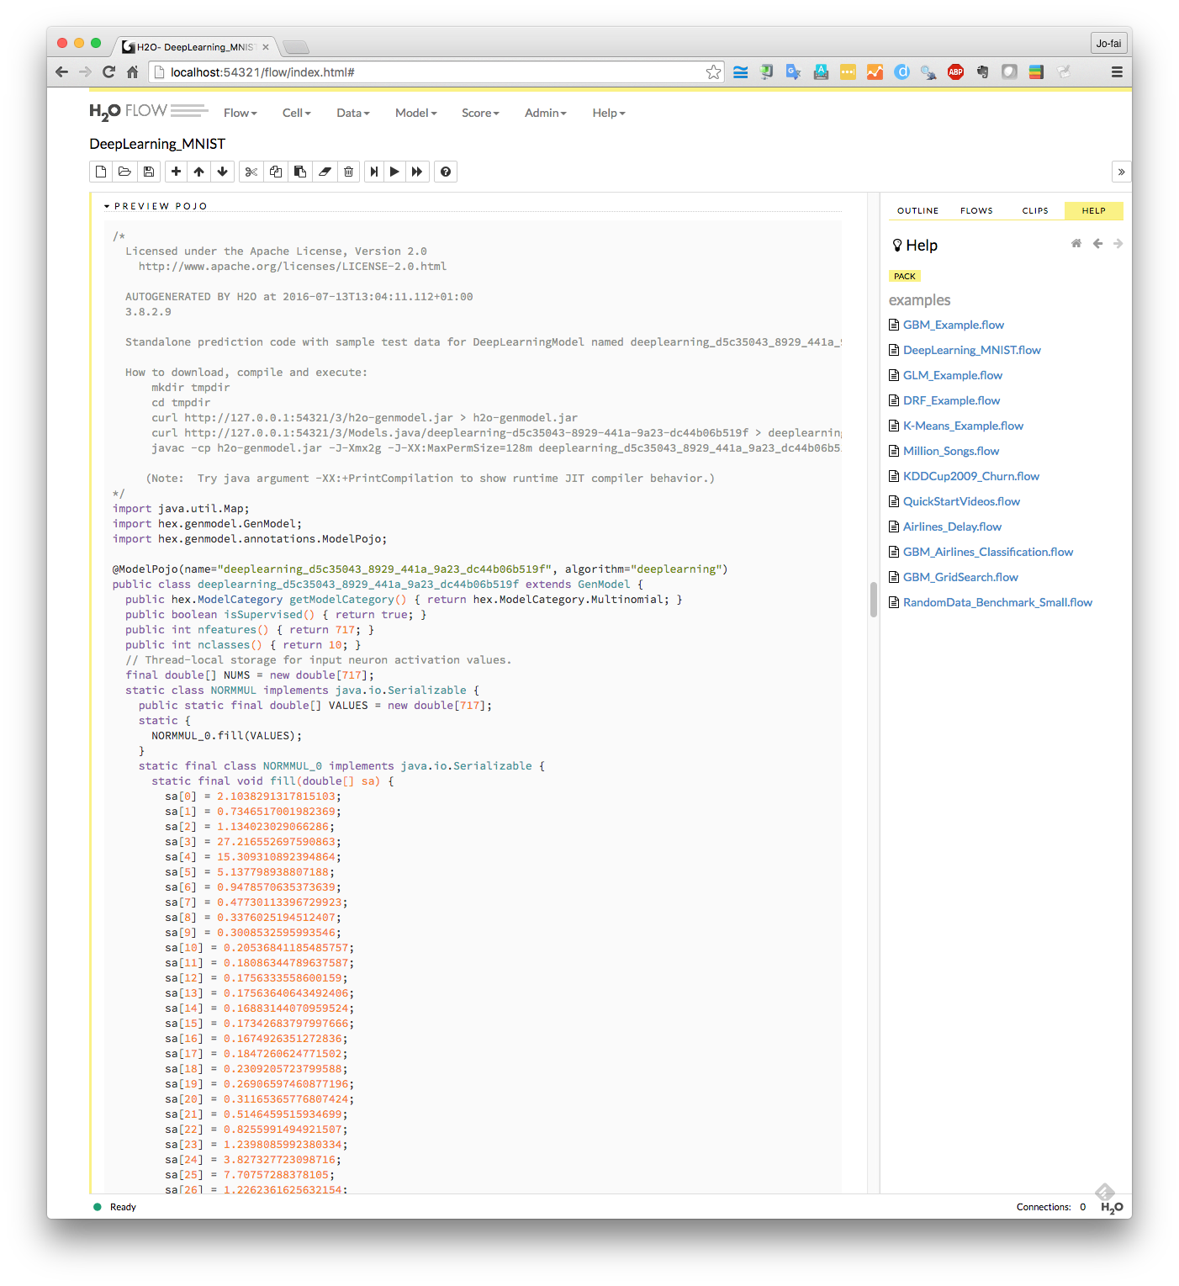
Export Plain Old Java Object (POJO)

Slide 11
Use Cases

Slide 12
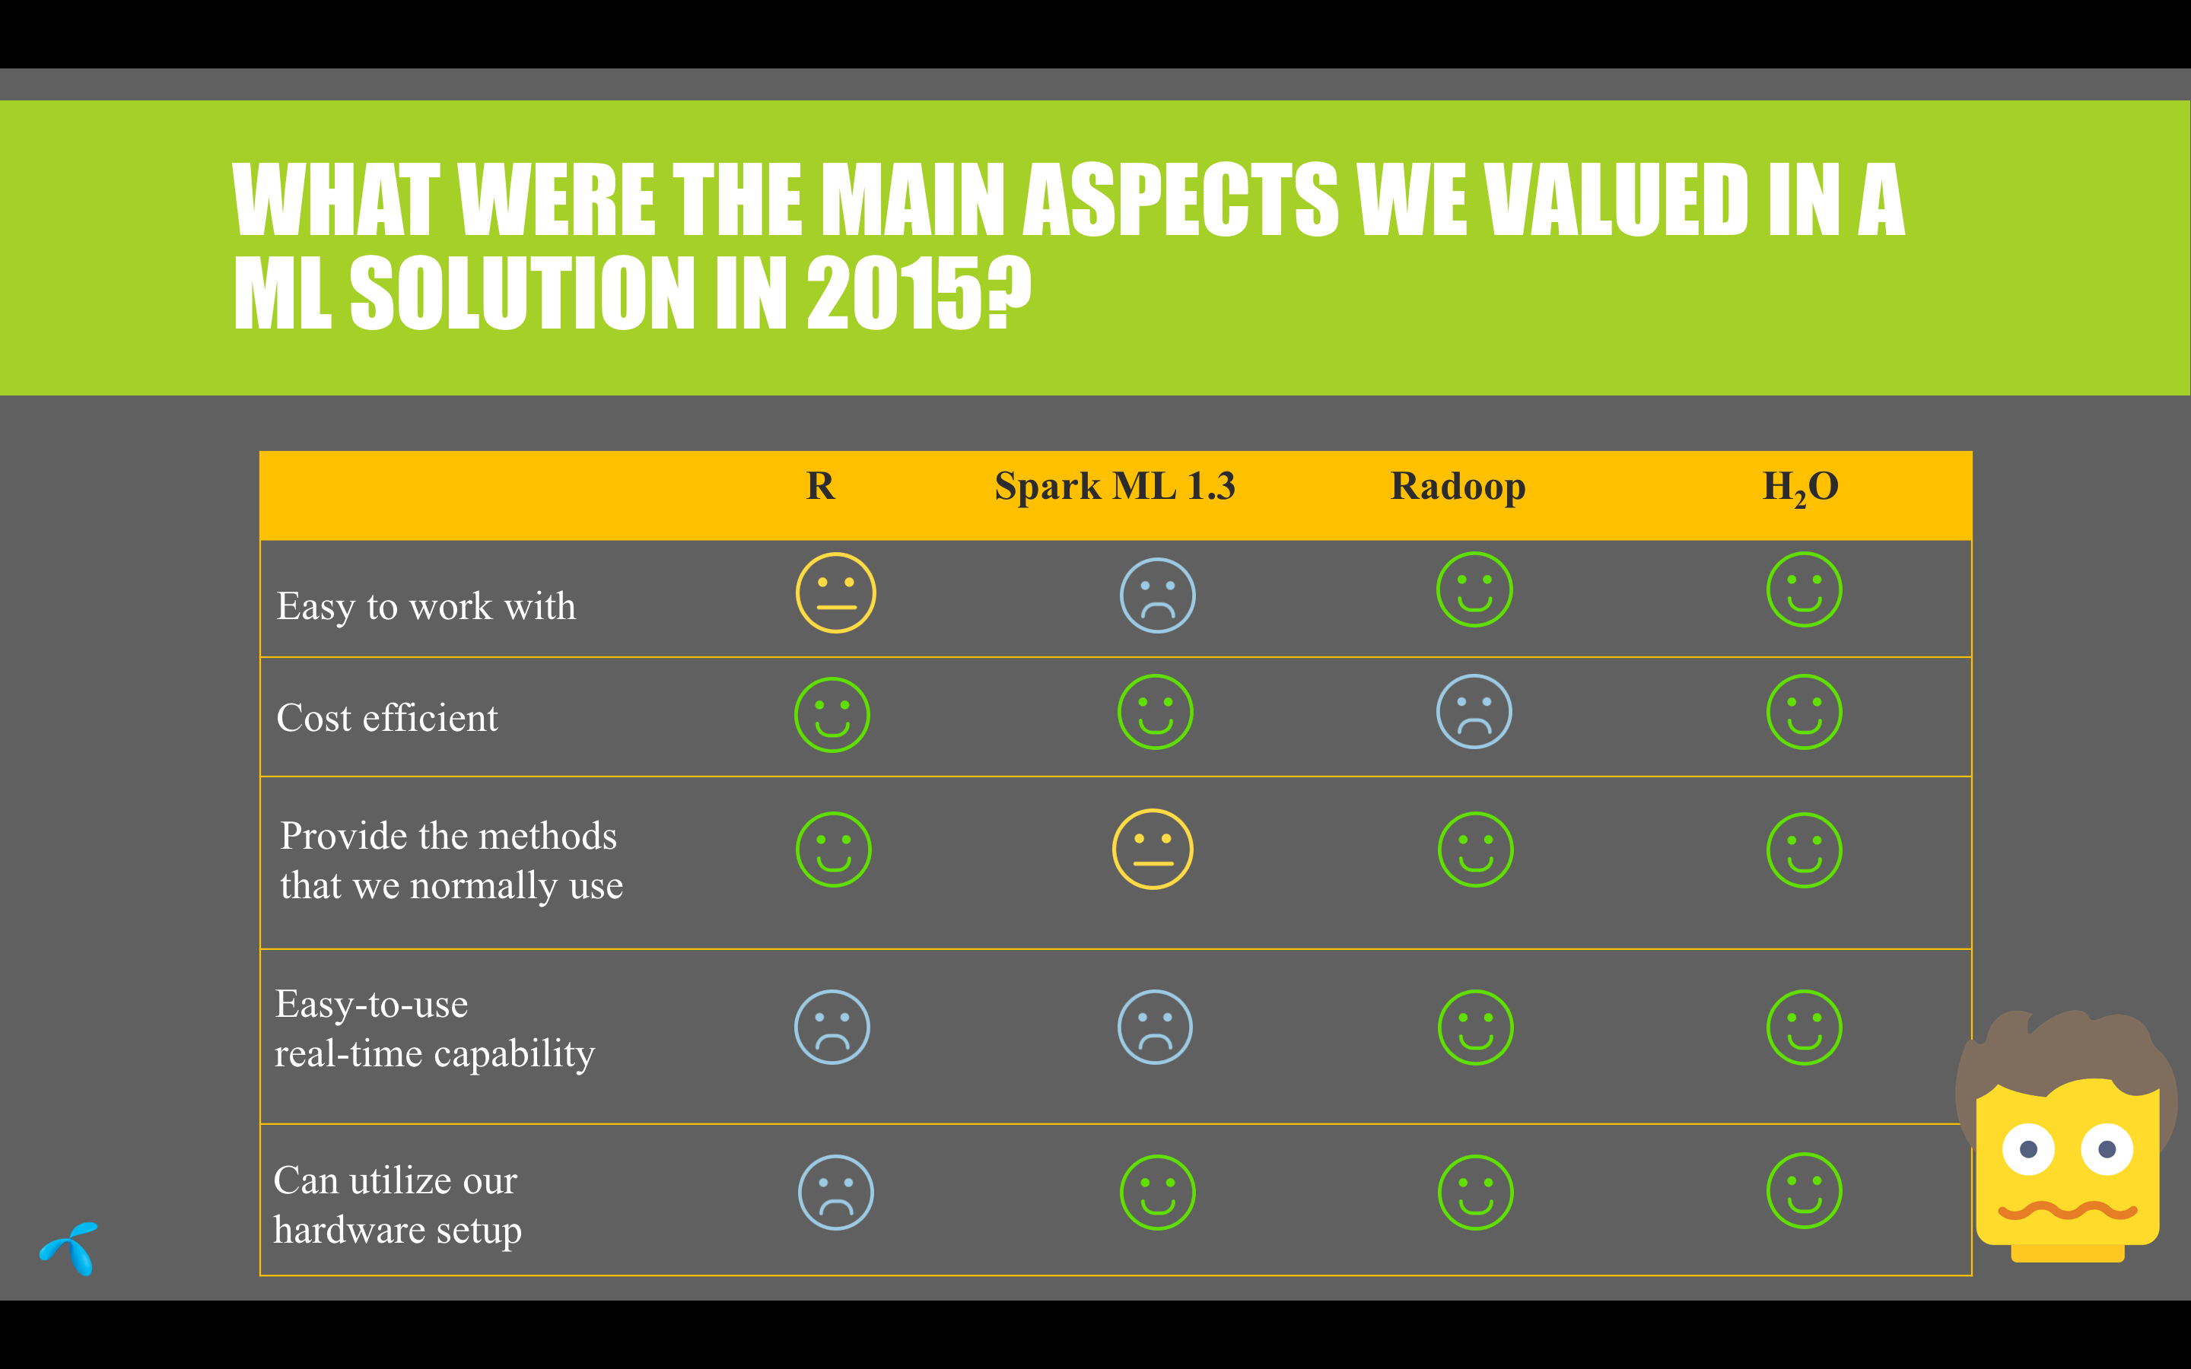
Telenor – Why H2O?

Slide 13
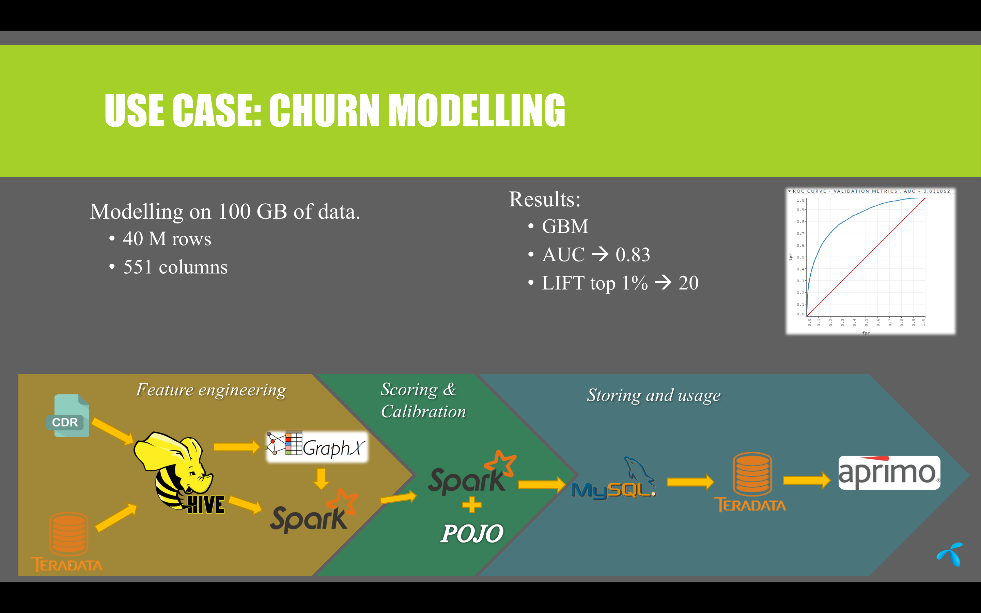
Telenor – Use Case

Slide 14
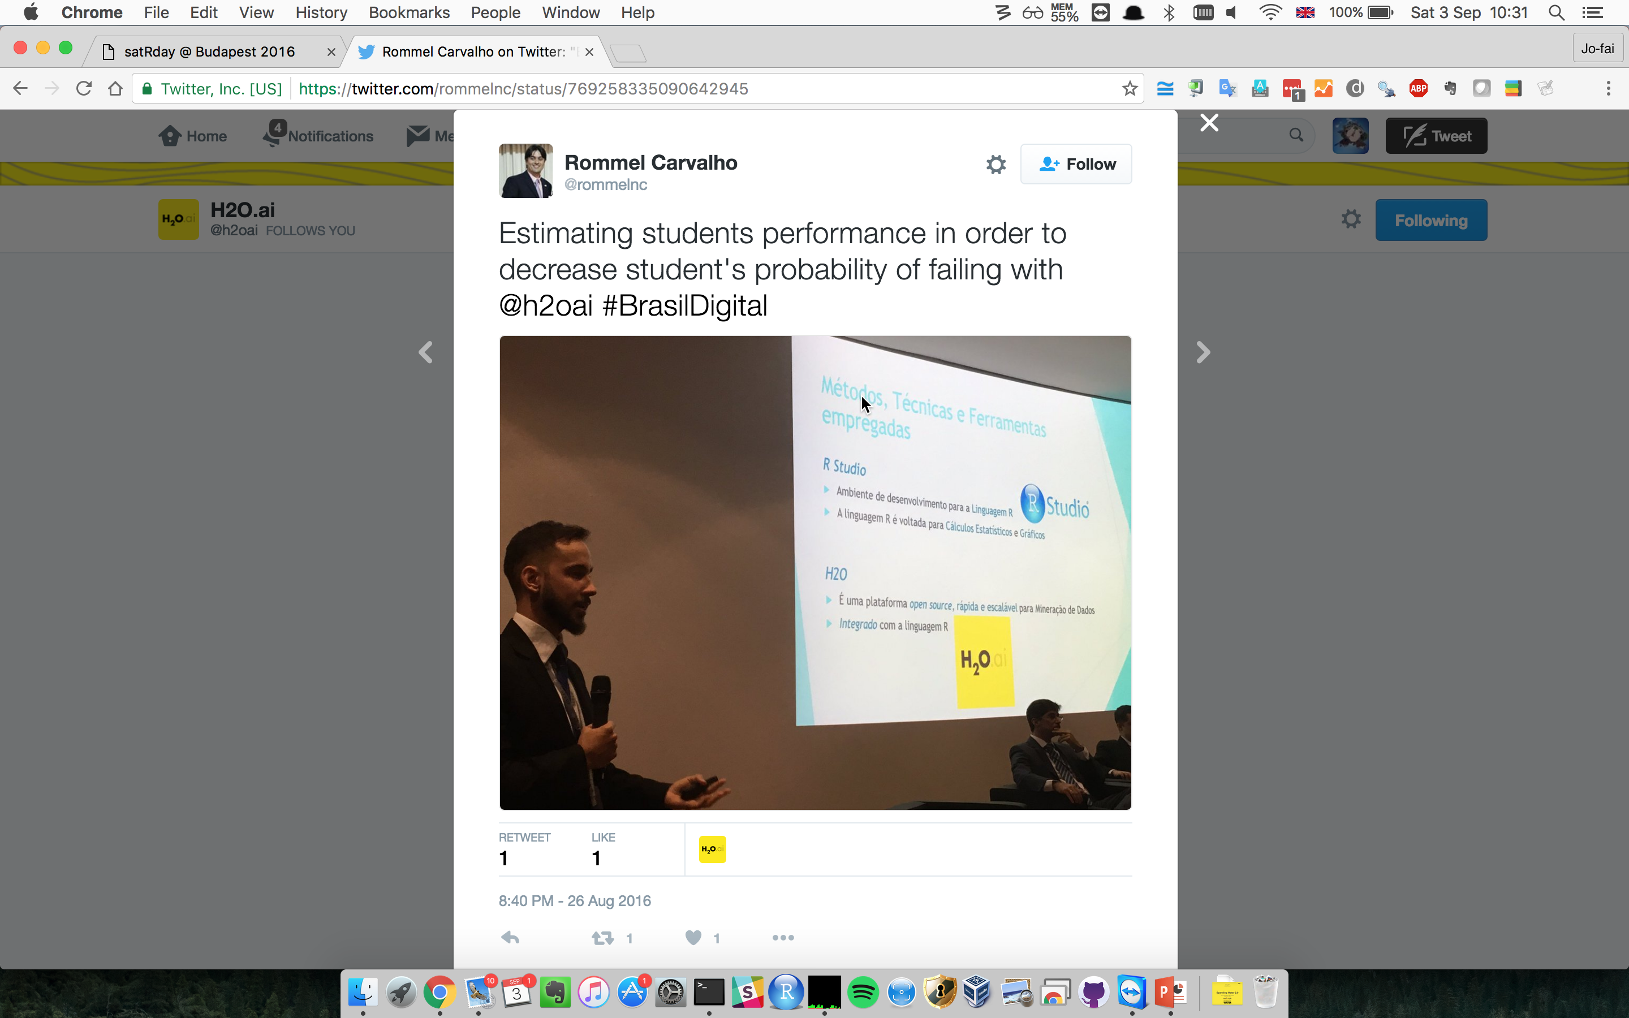
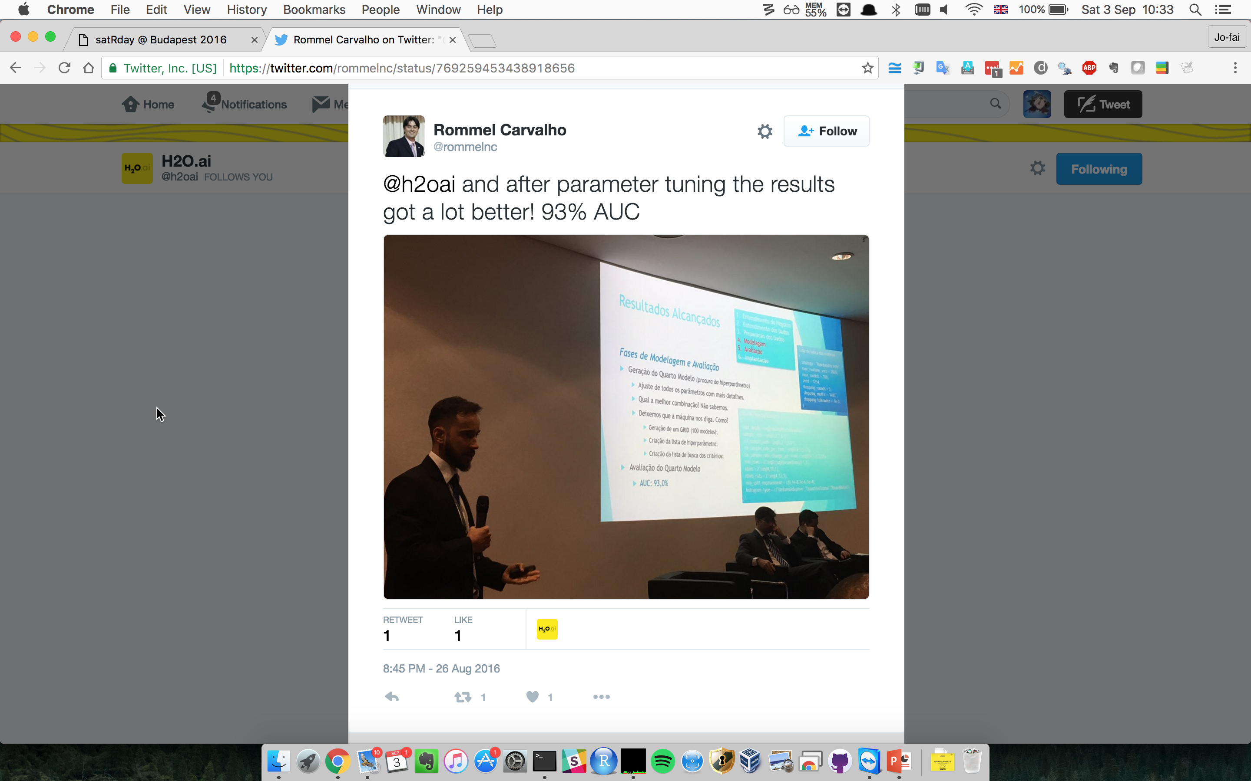
H2O in Brazil

Slide 15
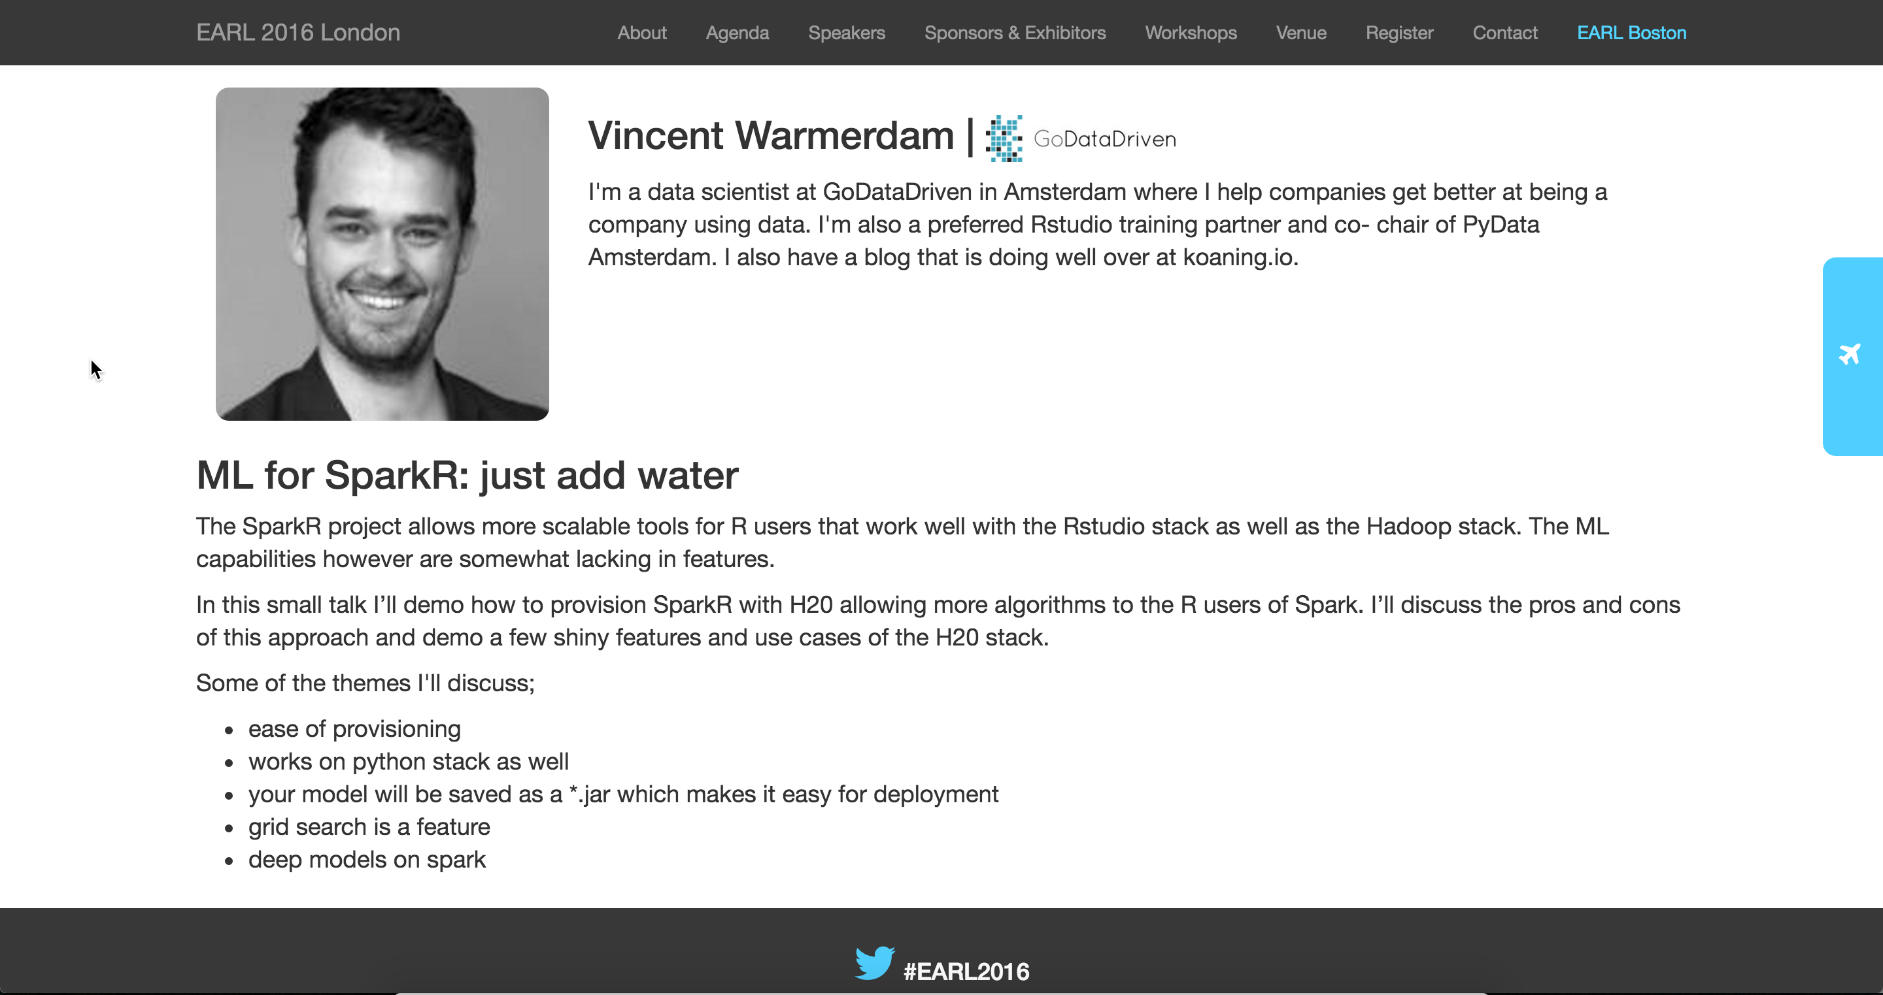
R + H2O + Spark at EARL 2016

Slide 16



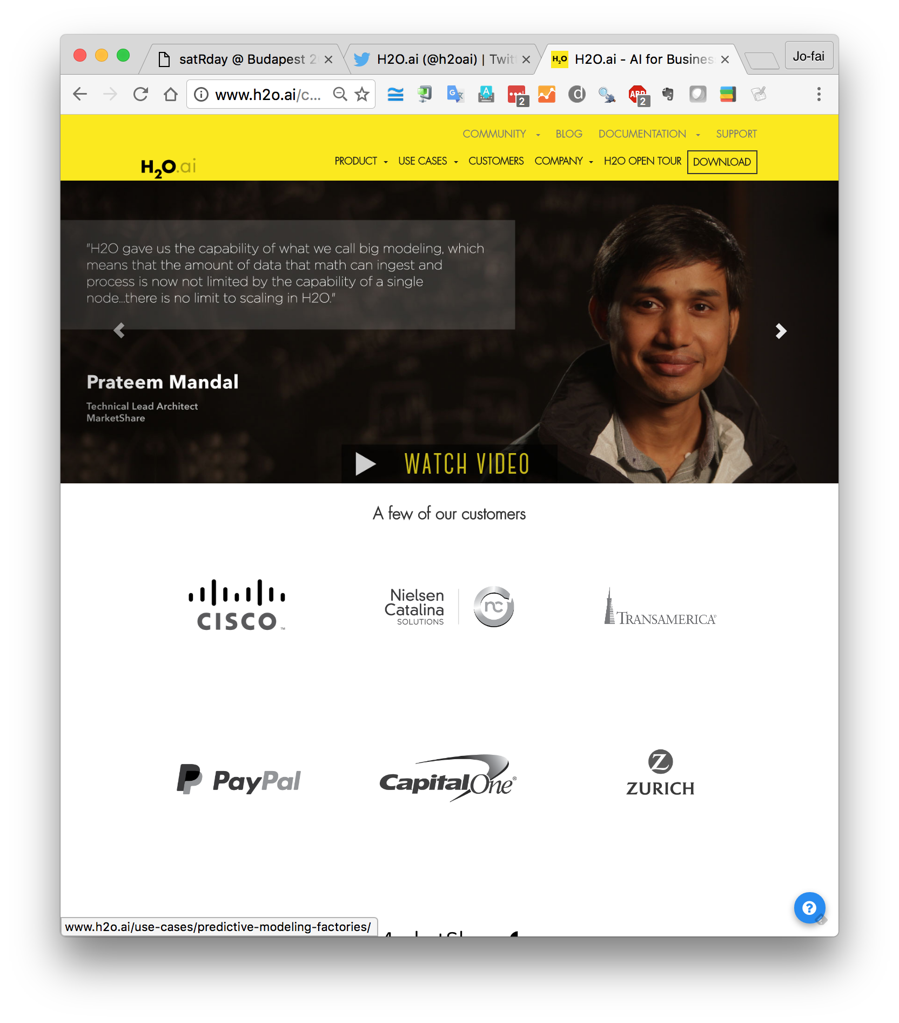
Our Customers

Slide 17
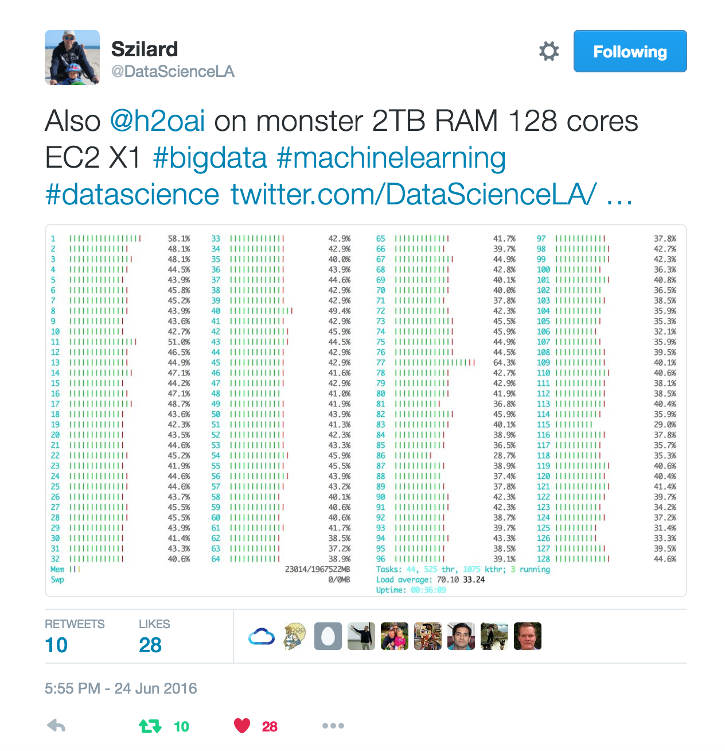
Szilard Pafka
Budapest DS Meetup
Big thanks to Szilard Pafka
Intro to ML with H2O
Link (video)
Link (Slides)

Slide 18
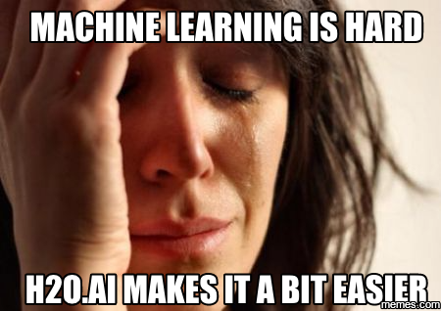
Szilard – Why H2O?
Szilard’s Summary Slide

Slide 19
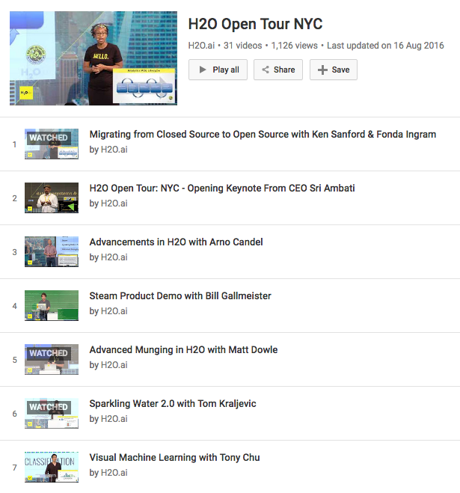
H2O is Evolving
Advanced data munging
Visual ML
Deep Water
H2O + TensorFlow, mxnet, Theano, Caffe …
GPU
Steam
YouTube Playlist

Slide 20
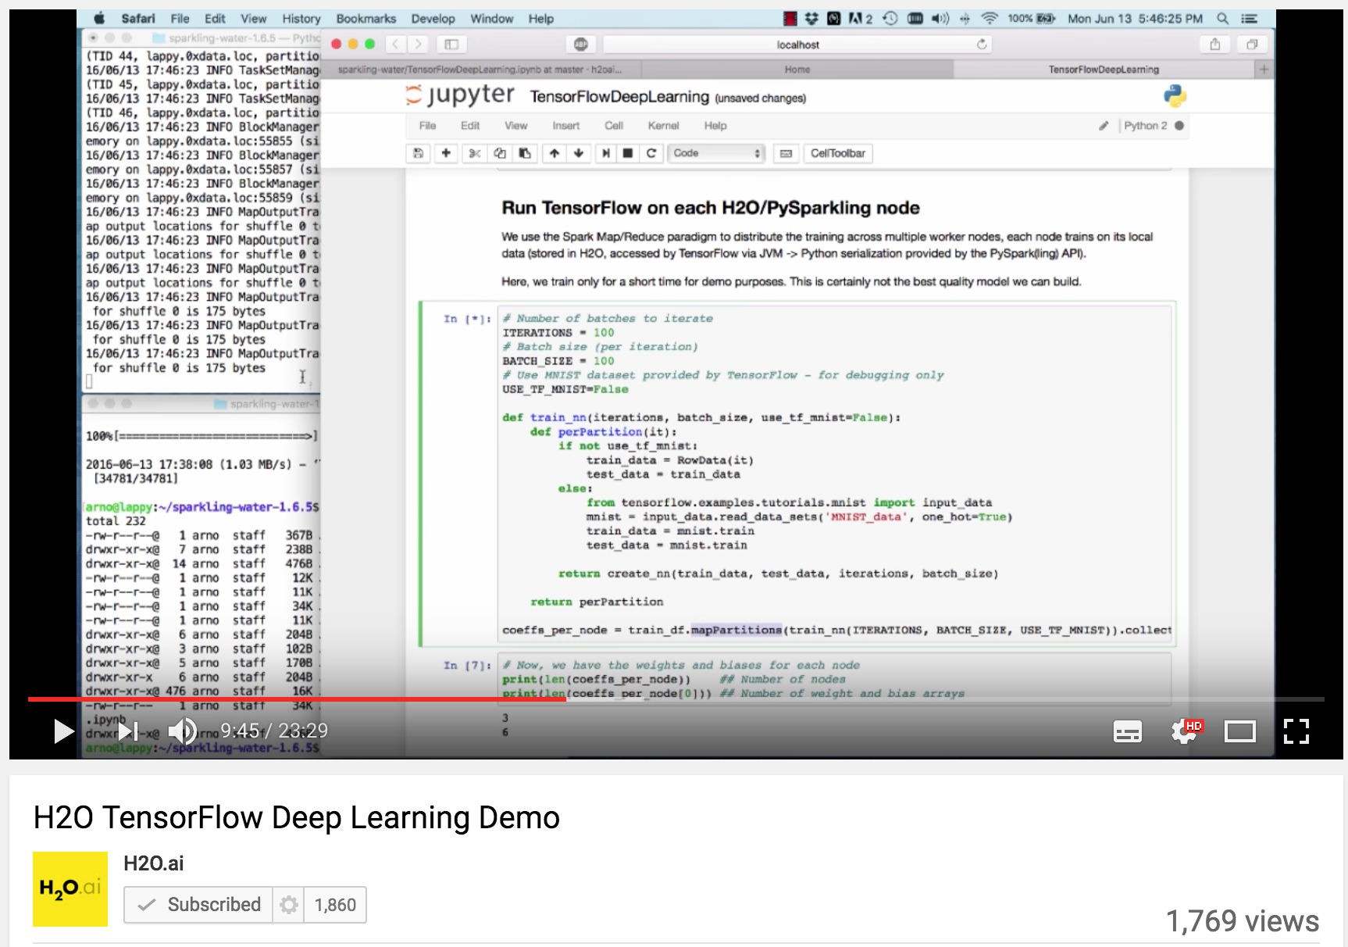
H2O Integration with Other Libraries
H2O + TensorFlow demo
H2O + MLLib SVM demo

Slide 21
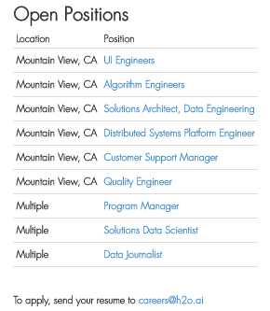
We’re Hiring!
Check it out
www.h2o.ai/careers/

Slide 22
Thanks!
Sponsors & Organizers
satRdays
Budapest Data Science Meetup
H2O.ai
Contact
joe@h2o.ai
@matlabulous
github.com/woobe
Resources
docs.h2o.ai
Slides and Code
github.com/h2oai/h2o-meetups

